Slide 1

UNIT I
18CSC301T – FORMAL LANGUAGE AND AUTOMATA
‹#›
Notes:
‹#›

Slide 2
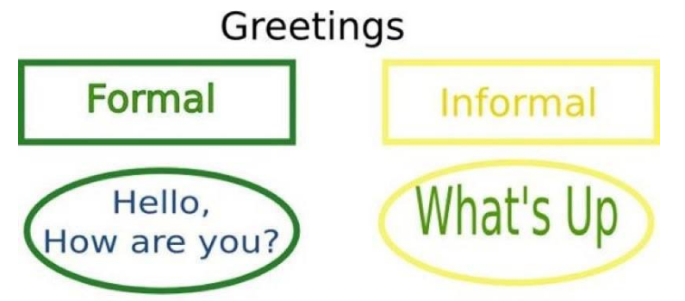
FORMAL LANGUAGES
A formal language is a set of strings of symbols drawn from a finite alphabet.
It is specified by:
a set of rules
by formal machine that accepts (recognize) the language.
‹#›

Slide 3
AUTOMATA THEORY
It is the study of abstract machines and the computation problems that can be solved using these machines. The abstract machine is called the automata.
The main motivation behind developing the automata theory was to develop methods to describe and analyse the dynamic behaviour of the machines.
The Formal Languages and Automata Theory appears in almost all fields of computer science under various disguises.
‹#›

Slide 4
ALLEN TURING
Turing Award is an annual prize given by the Association for Computing Machinery (ACM).
An individual selected for contributions of a technical nature made to the computing community.
The Turing Award is recognized as the "highest distinction in computer science" and "Nobel Prize of Computing“.
He is known as father of Artificial Intelligence.
Turing machine: stored program concept
‹#›

Slide 5

UNIT 1
Introduction to Automaton
Mathematical concepts
Formal Languages: Strings, Languages, Properties
Finite Representation : Regular Expressions
Problems related to regular expressions
Finite Automata :Deterministic Finite Automata
Nondeterministic Finite Automata
Finite Automaton with €- moves
Problems related to Deterministic and Nondeterministic Finite Automata
Problems related to Finite Automaton with €- moves
Minimization of DFA
Problems related to Minimization of DFA
Regular Languages : Equivalence of Finite Automata and Regular Languages
Equivalence of Finite Automata and Regular Grammars
Problems related to Equivalence of Finite Automata and Regular Languages and Regular Grammars
Variants of Finite Automata :Two-way Finite Automaton Mealy Machines
Properties of Regular Languages: Closure Properties
Set Theoretic Properties & Other Properties
Pumping Lemma
‹#›

Slide 6
Introduction of Automaton
An automata is an abstract self-propelled computing device which follows a predetermined sequence of operations automatically.
Automata-based programming is a programming paradigm in which the program or its part, is thought as a model of a finite state machine or any other formal automation.
What is Automata Theory?
Automata theory is the study of abstract computational devices
Abstract devices are (simplified) models of real computations
Computations happen everywhere: On your laptop, on your cell phone, in nature, …
‹#›

Slide 7
Simple Computer
Example:
input : switch
Output : light bulb
Actions : flip switch
States : on, off
bulb is on if and only if there was an odd number of flips
OTHER EXAMPLES
Electric Switch
Fan Regulator
Automatic door controller
Binary string with divisible by 4
BATTERY
f
start
off
on
f
‹#›

Slide 8
Types of Automata
finite automata | Devices with a finite amount of memory. Used to model “small” computers.
push-down automata | Devices with infinite memory that can be accessed in a restricted way. Used to model parsers, etc.
Turing Machines | Devices with infinite memory. Used to model any computer.
‹#›

Slide 9


Introduction of Formal Proof - Basic Definitions
Alphabet - a finite set of symbols.
Examples: Binary alphabet {0,1}, English alphabet {a,...,z,!,?,...}
2. String over an alphabet Σ - a finite sequence of symbols from Σ.
Notation: (a) Letters u, v, w, x, y, and z denote strings.
(b) Convention: concatenate the symbols. No parentheses or commas used.
3. Empty string: e or ε denotes the empty sequence of symbols.
4. Language over alphabet Σ - a set of strings over Σ.
Notation: L.
Examples:
{0, 00, 000, ...} is an "infinite" language over the binary alphabet.
{a, b, c} is a "finite" language over the English alphabet.
‹#›

Slide 10
5. Empty language - empty set of strings. Notation: Φ.
6. Binary operation on strings: Concatenation of two strings u.v - concatenate the symbols of u and v.
Notation: uv
Examples: Let u=00 and v=11, then concatenation of uv
00.11 = 0011.
ε.u = u.ε = u for every u. (identity for concatenation)
‹#›

Slide 11
What are the permissible alphabets to name a variable in C language?
A) Letters
B) Digits
C) Underscore
D) delimiter (;, ,, ., :)
Answer: A, B and C
‹#›

Slide 12
Binary relations on strings
Prefix - u is a prefix of v if there is a w such that v = uw.
Examples:
ε is a prefix of 0 since 0 = ε0
apple is a prefix of appleton since appleton = apple.ton
Suffix - u is a suffix of v if there is a w such that v = wu.
Examples:
0 is a suffix of 0
ton is a suffix of appleton
‹#›

Slide 13
Substring - u is a substring of v if there are x and y such that v = xuy.
Examples:
let is a substring of appleton since appleton = app.let.on
0 is a substring of 0 since 0 = epsilon.0.epsilon
Observe that prefix and suffix are special cases
of substring.
‹#›

Slide 14
Introduction to Mathematical concepts
Inductive Proof
Mathematical technique which is used to prove a statement, a formula or a theorem is true for every natural number.
Three steps:
Base or basis: Prove that a statement is true for the initial value.
Induction − Assume that statement is true for the n^{th} iteration (n)
Proof: Prove that statement is true for (n+1)^{th} iteration ( n+1).
Deductive Proof
Consists of sequence of statements whose truth lead us from some initial statement called the hypothesis or the give statement to a conclusion statement.
Example: If H then C
C is deduced from H
‹#›

Slide 15
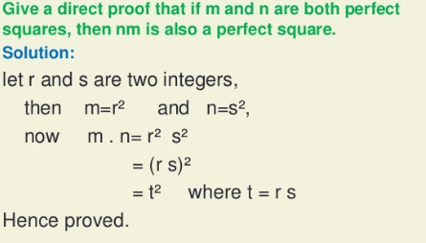
Direct Proof
way of showing the truth or falsehood of a given statement by a straightforward combination of established facts, usually axioms, existing lemmas and theorems, without making any further assumptions.
Proof by Contrapositive
To prove a statement of the form “If A, then B,” :
Form the contrapositive- negate A and B.
Prove directly that ¬B implies ¬A
Statement:
If it is raining, then the grass is wet.
Contrapositive:
If the grass is not wet, then it is not raining.
‹#›
Notes:
‹#›

Slide 16
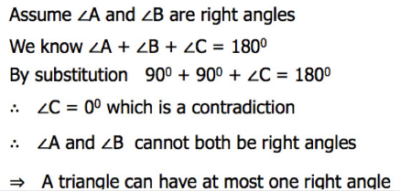
Proof by Contradiction
(Indirect proof)
Proof by Counter Example
Proof by contradiction is a form of proof that establishes the truth or the validity of a proposition, by showing that assuming the proposition to be false leads to a contradiction.
Proof by counterexample is the technique in mathematics where a statement is shown to be wrong by finding a single example whereby it is not satisfied.
Example:
Prove or disprove the statement that all prime numbers are odd.
Proof:
2 is a prime number but it is not odd.
We have found an example of when the statement is not true.
This disproves the statement by counterexample.
Example: A triangle ABC cannot have more than one right angle.
‹#›

Slide 17
Theorem vs Lemma
Lemma: Mathematical result that is useful for verifying another result
Theorem: A true mathematical statement.
‹#›

Slide 18
Regular Expressions (RE)
They are shorthand notations to represent a language.
Languages represented by RE is called regular languages.
Regular languages are languages that can be generated from one-element languages by applying certain standard operations a finite number of times.
Rules of RE:
Every letter of the alphabet ∑ is a regular expression.
Null string є and empty set Φ are regular expressions.
If r1 and r2 are regular expressions, then
r1r2 ( concatenation of r1r2 )
r1 + r2 ( union of r1 and r2 )
r1*, r2* ( kleen closure of r1 and r2 ) are also regular expressions
If a string can be derived from the rules 1, 2 and 3 then it is also a regular expression.
‹#›

Slide 19
OPERATIONS ON REGULAR EXPRESSIONS
For two regular expressions r1 and r2
a) r1 + r2 is a regular expression denoting union of L(r1) and L(r2).
L(r1 + r2) = L(r1) U L(r2)
r1r2 is a regular expression denoting the concatenation of L(r1) and L(r2). L(r1r2) = L(r1) . L(r2)
c) r* is a regular expression denoting the closure of L(r). That is L(r*) = L(r)*
‹#›

Slide 20
Example: Consider r1={a,b} r2={0,1}
Union:
r1+r2={a,b,0,1} // set of alphabets or digits
Concatenation:
r1.r2=r1r2={a0,a1,b0,b1} //set of alphabets and digits
3. Kleen’s Closure
r1* ={Є, a, aa, aaa, aaaa, …, b, bb, bbb, …} //0 or any number of times repeating the symbols
4. Positive Closure
r1+={a, aa, aaa, …, b, bb, bbb, …} //1 or any number of times repeating the symbols
‹#›

Slide 21
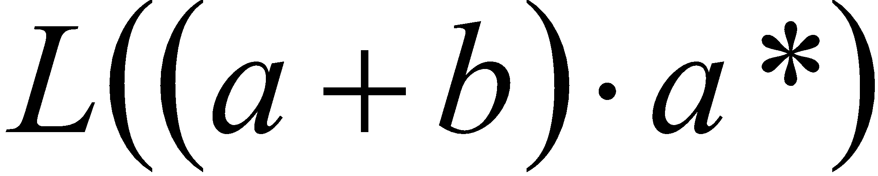
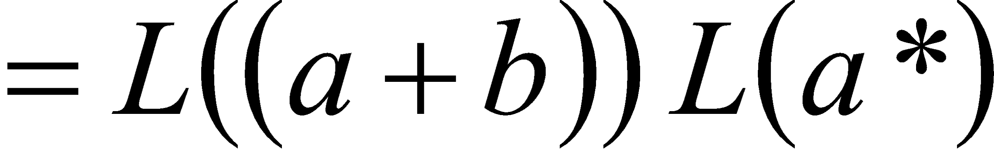
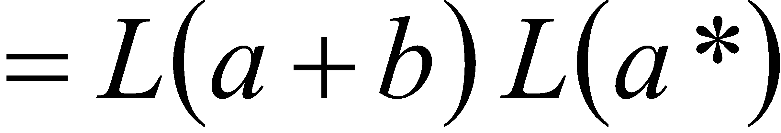
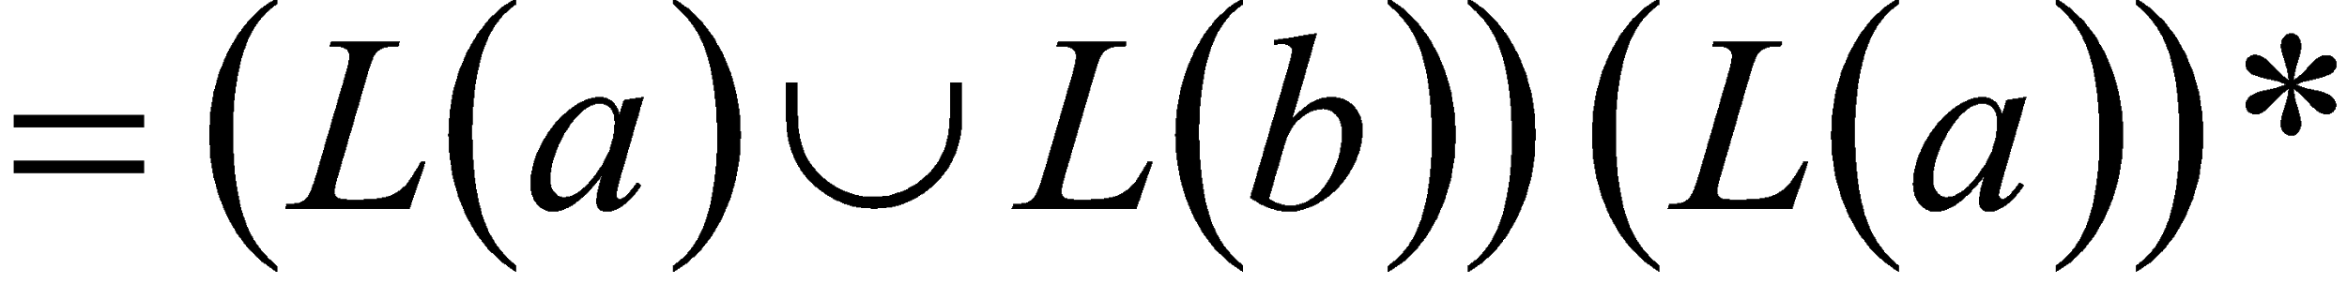

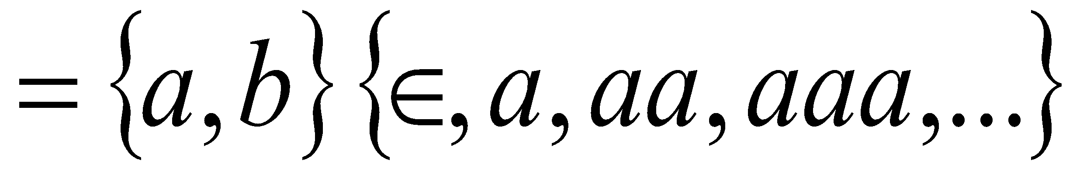
Generate the strings from the regular expression R1=(a+b).a*
‹#›

Slide 22
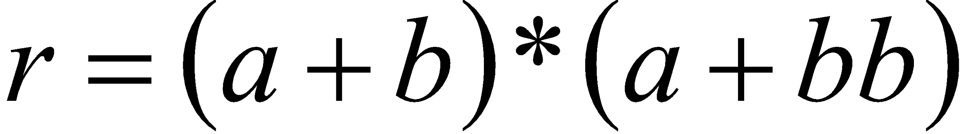
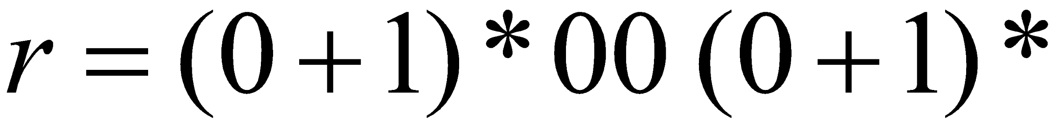
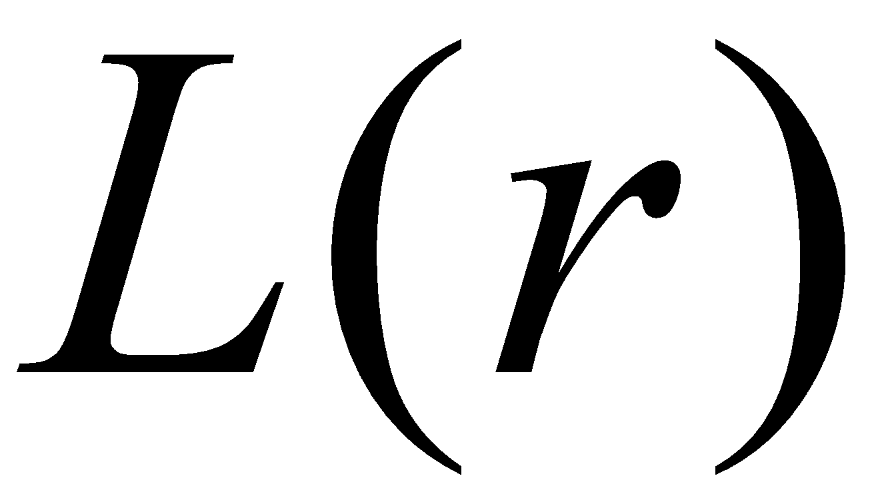
Regular Expressions
Regular expression
Regular expression
= { all strings containing substring 00 }
‹#›

Slide 23
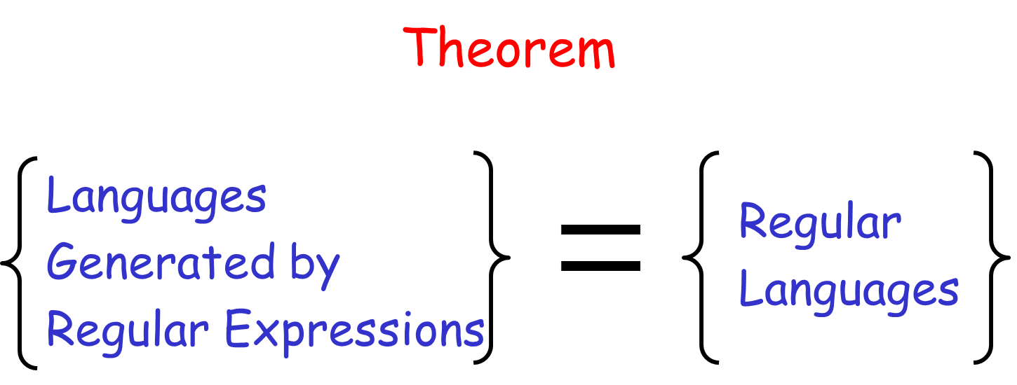
‹#›

Slide 24
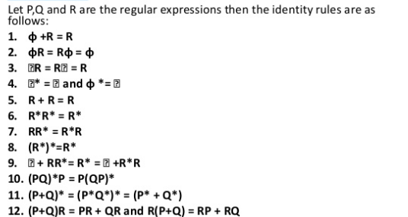
IDENTITY RULES
‹#›

Slide 25
Solve Problems in Regular Expressions
Construct RE for the following:
1. Strings of 0’s and 1’s.
2. Set of all strings of a’s and b’s ending with bb over Σ={a, b}
3. Set of strings that begin with 0 and end with 1 over Σ={0, 1}
4. Set of strings with two consecutive a’s over Σ={a, b}
Set of strings ending with abc over over Σ={a, b, c}
6. Set of strings with atleast one 1 and one 0 over Σ={0, 1}
‹#›

Slide 26
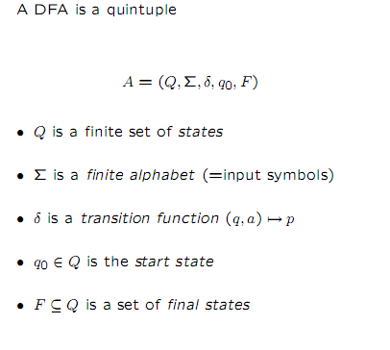
Deterministic Finite Automata (DFA)
‹#›

Slide 27

FINITE STATE MACHINES
Simplest computational model
States represent the status of a system.
Finite-state machines may also contain one or multiple accepting states.
States are connected with each other using transitions.
Each transition contains a set of symbols.
The set of all symbols presented in the FSM is called the alphabet.
When the source state is active and the transition is executed, it changes the active state from the source state to the destination state only if the current input matches the symbol of the transition.
‹#›

Slide 28
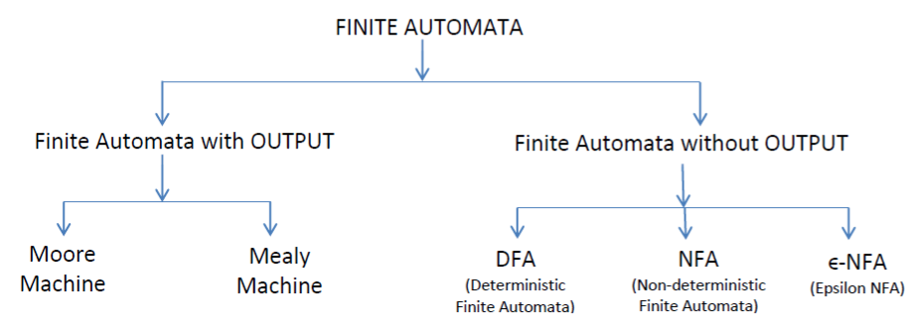
‹#›

Slide 29
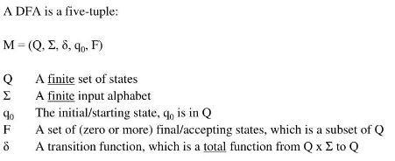
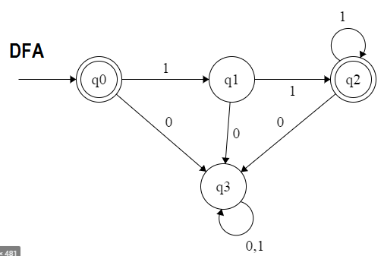
DETERMINISTIC FINITE STATE AUTOMATA
In DFA, for each input symbol, one can determine the state to which the machine will move.
Formal definition
Example: Traffic signals. Red and green cannot glow simultaneously
‹#›

Slide 30
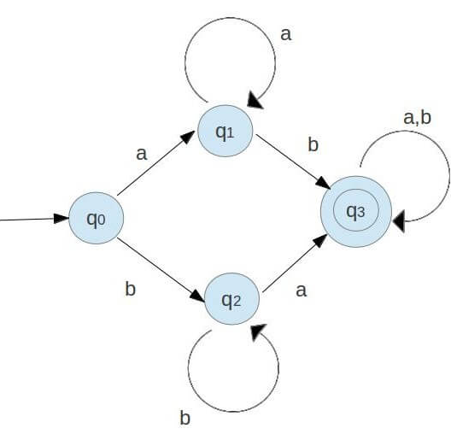
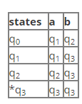
Transition table
A transition table is a conventional tabular representation of functions like δ that takes the two argument and returns another state.
The row of the table corresponding to the states.
The column of the table corresponding to the inputs.
‹#›

Slide 31
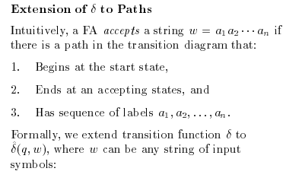
Extending the Transition functions to the strings
‹#›

Slide 32
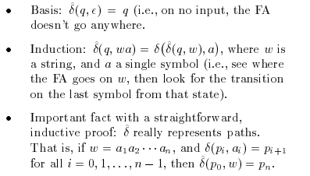
‹#›

Slide 33
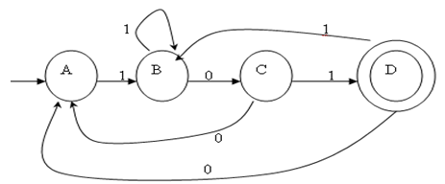
Consider the following transition diagram and to check the input string 110111,011101 is accepted or not.
W=110111
δ( A,є) =A.
δ( A,1) =B.
δ( A,11) =δ( A,1),1 =δ( B,1) =B.
δ( A,110) =δ( A,11),0 =δ( B,0) = C.
δ( A,1101) =δ( A,110),1 =δ( C,1) = D.
δ( A,11010) =δ( A,1101),0 =δ( D,1) = B.
δ( A,110101) =δ( A,11010),0 =δ( B,1) = B.
It does not reach the final state.
The given string is not accepted by DFA.
‹#›

Slide 34
CONSTRUCTION OF DFA-TYPES
1. Ending with
Eg: Construct a DFA over input Σ={0,1} that accepts strings ending with 01.
2. Starting with
Eg: Construct a DFA over input Σ={0,1} that accepts strings starting with 001.
3. Substring
Eg: Construct a DFA over input Σ={a, b, c} that accepts strings with bbb as substring.
Does not contain
Eg: Construct a DFA over input Σ={a, b, c} that accepts strings which does not contain bbb.
5. Divisibility
Construct a DFA over input Σ={0,1} that accepts numbers that are divisible by five.
6. Even / Odd
Construct a DFA over the input Σ={0,1} that accepts odd number of 1s and even no of 0.
‹#›

Slide 35
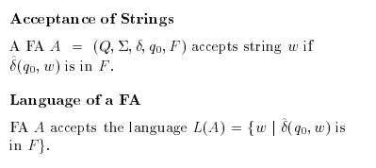
Language of DFA
‹#›

Slide 36
Regular Languages
Definition: A Language is regular iff there is a DFA that accepts it.
Examples:
φ
{ε}
Σ*
{w in {0,1}* | second symbol of w is a 1}
{w in {0,1}* | second last symbol of w is a 1}
{w in {0,1}* | w contains 010 as a substring}
‹#›

Slide 37
Nondeterministic Finite Automaton (NFA)
Generalization of DFA. Allows:
0 or more next states for the same (q, σ).
Guessing
Transitions labeled by the empty string.
Changing state without reading input
Motivation: Flexibility.
Easier to prove many closure properties.
‹#›

Slide 38
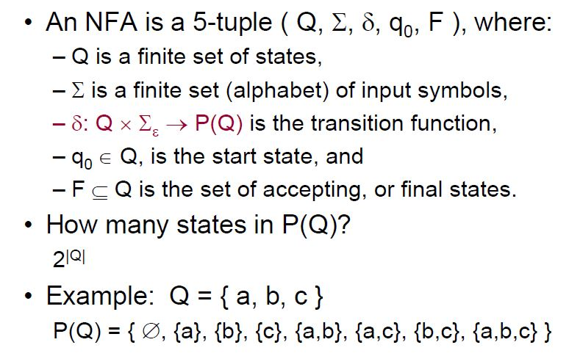
Nondeterministic Finite Automata:
‹#›

Slide 39
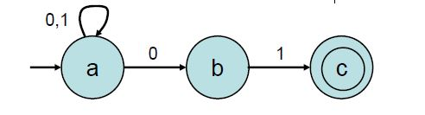
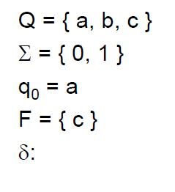
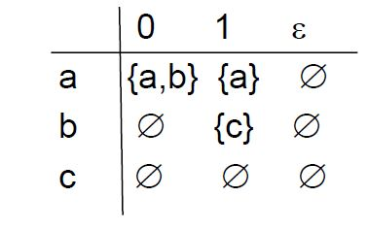
Nondeterministic Finite Automata:
NFA that reads strings ending with 01
‹#›

Slide 40
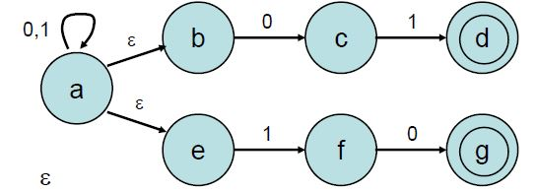
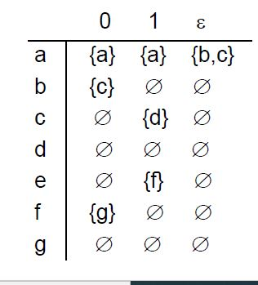
Nondeterministic Finite Automata:
NFA Example
‹#›

Slide 41
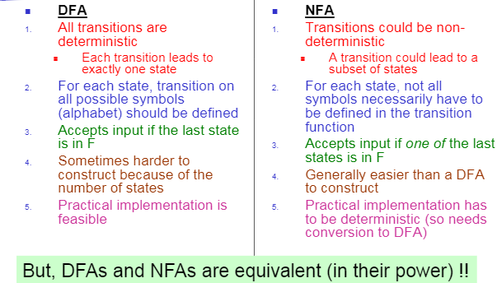
‹#›

Slide 42
Conversion of NFA to DFA
Subset Construction Method
Create the start state of the DFA by taking the -closure of the start state of the NFA.
Perform the following for the new DFA state: For each possible input symbol:
Apply move to the newly-created state and the input symbol; this will return a set of states.
Apply the -closure to this set of states, possibly resulting in a new set.
3. This set of NFA states will be a single state in the DFA.
Each time we generate a new DFA state, we must apply step 2 to it. The process is complete when applying step 2 does not yield any new states.
The finish states of the DFA are those which contain any of the finish states of the NFA
‹#›

Slide 43
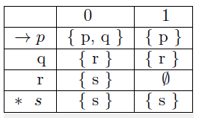
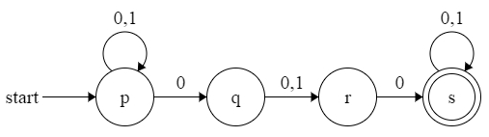
1. Convert the given NFA to DFA
Step 1: Construct all possible reachable subsets from the given table
Step 2: Rename and redraw only the reachable subsets. Now this will be a DFA.
‹#›

Slide 44
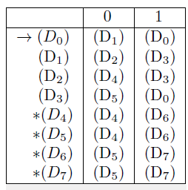
‹#›

Slide 45
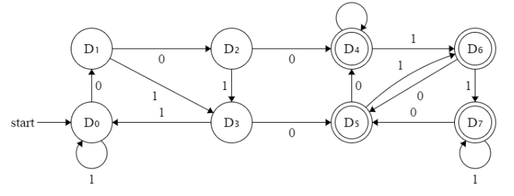
NFA
DFA
‹#›

Slide 46
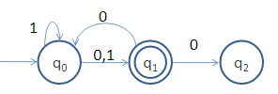
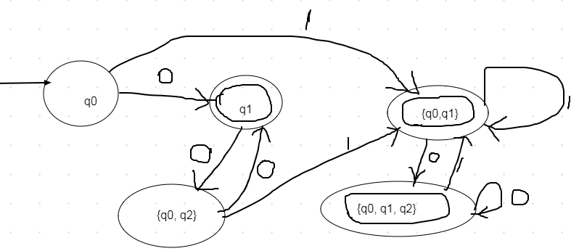
2. Convert the following NFA to DFA
States | 0 | 1
Φ | Φ | Φ
q0 | {q1} | {q0, q1}
*q1 | {q0, q2} | Φ
*{q0,q1} | {q0, q1,q2} | {q0, q1}
{q0, q2} | {q1} | {q0,q1}
*{q0,q1,q2} | {q1, q0,q2} | {q0, q1}
‹#›

Slide 47
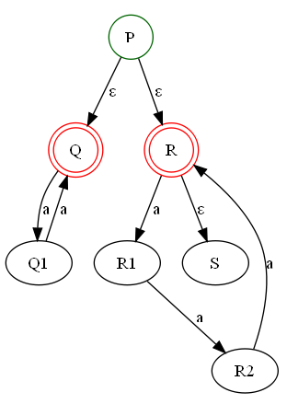
Epsilon Transitions
ε- NFA: The automaton may be allowed to change its state without reading the input symbol.
They do not extend the class of languages that can be represented.
Both NFAs and ε-NFAs recognize exactly the same languages.
ε-Closure of a state
The ε-closure of the state q, denoted ECLOSE(q), is the set that contains q, together with all states that can be reached starting at q by following only ε-transitions.
Find the E-closure of all states
ECLOSE(P) ={P,Q,R,S}
ECLOSE(R)={R,S}
ECLOSE(Q)={Q}
ECLOSE(R1)={R1}
ECLOSE(S)={S}
ECLOSE(R2)={R2}
‹#›

Slide 48
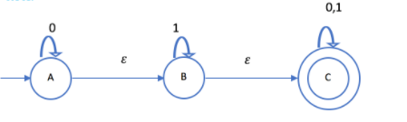
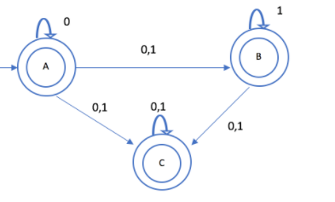
1. Convert the following ε-NFA to NFA.
Step 2: Fill the epsilon closures for input transitions
States | 0 | 1
ECLOSE(A)={A,B,C} | {A,B,C} | {B,C}
ECLOSE(B)={B,C} | {C} | {B,C}
ECLOSE(C)={C} | {C} | {C}
Step 1: Compute ε closure of all states
ECLOSE(A)={A,B,C}
ECLOSE(B)={B,C}
ECLOSE(C)={C}
δ(ECLOSE(A),0)
= δ ({A,B,C},0)
= δ(A,0)U δ(B,0)U δ(C,0)
={A,C}
ECLOSE({A,C})={A,B,C}
‹#›

Slide 49
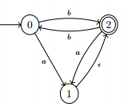
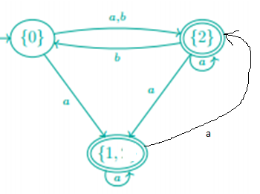
2. Convert the following ε-NFA to NFA.
Step 2: Fill the epsilon closures for input transitions
States | a | b
ECLOSE(0)={0} | {1,2} | {2}
ECLOSE(1)={1,2} | {1,2} | {0}
ECLOSE(2)={2} | {1,2} | {0}
ECLOSE(0)={0}
ECLOSE(1)={1,2}
ECLOSE(2)={2}
δ(ECLOSE(0),a)
= δ ({0},a)
= {1}
ECLOSE({1})={1,2}
‹#›

Slide 50
Closure properties of regular languages.
Previously we saw closure under ∪ and ∩.
New: Regular languages are closed under
Concatenation
Kleene star
Complement.
‹#›

Slide 51
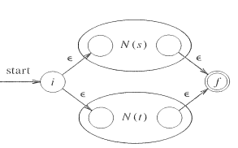
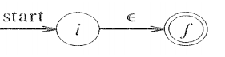
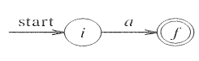
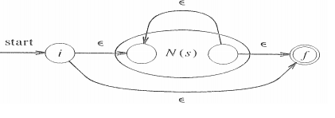
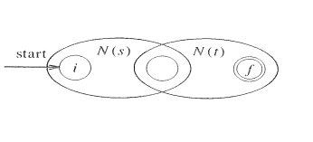
REGULAR EXPRESSIONS AND NFA: THOMPSON’S CONSTRUCTION
Regular expressions generate exactly the class of regular languages.
Theorem:
(a) For every regular expression there is an equivalent NFA
(b) For every DFA there is an equivalent regular expression.
Basis : r=ε
R=s|t
R=a
R=s*
R=st
‹#›

Slide 52
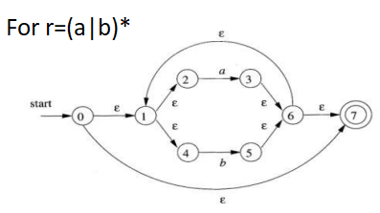
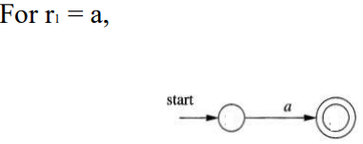
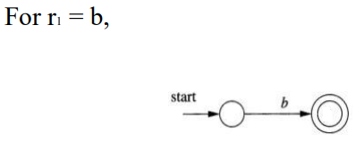
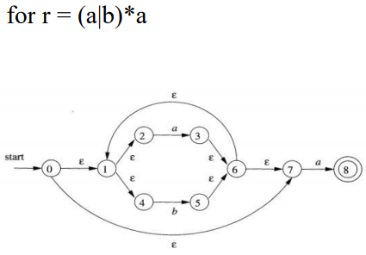

1. Construct an NFA for r = (a|b)*a
‹#›

Slide 53





1. Construct NFA for R=((a.b)|c)*
For r1=a; r2=b
For r5=(ab)|c
For r6=((ab)|c)*
For r3=r1.r2
For r4=c
‹#›

Slide 54
CONVERSION OF ε NFA TO DFA
Step 1: We will take the ε-closure for the starting state of NFA as a starting state of DFA.
Step 2: Find the states for each input symbol that can be traversed from the present. That means the union of transition value and their closures for each state of NFA present in the current state of DFA.
Step 3: If we found a new state, take it as current state and repeat step 2.
Step 4: Repeat Step 2 and Step 3 until there is no new state present in the transition table of DFA.
Step 5: Mark the states of DFA as a final state which contains the final state of NFA
‹#›

Slide 55


Convert the following E-NFA to DFA
Step 1: Find E-closure of all states
‹#›

Slide 56


Step 2: Find the transitions let ε-closure {q0} = {q0, q1, q2} be state A.
Find transitions of B
‹#›

Slide 57


Find transitions of C
States | 0 | 1
A | B | B
B | B | C
*C | Φ | Φ
‹#›

Slide 58



2. Convert the following e-NFA to DFA
Step 2: Find the transitions
Step 1: find Eclosure of all states
Let {q0,q1,q2} be A
‹#›

Slide 59


Transitions for B
Transitions for C
States | 0 | 1 | 2
A | A | B | C
B | Φ | B | C
C | Φ | Φ | C
‹#›

Slide 60

States | 0 | 1 | 2
A | A | B | C
B | Φ | B | C
C | Φ | Φ | C
DFA
‹#›

Slide 61

NFA vs DFA vs ε-NFA
‹#›
Notes:
‹#›

Slide 62
MINIMIZATION OF DFA
DFA minimization converting a given DFA to its equivalent DFA with minimum number of states.
Two or more states can be combined if they are indistinguishable. Else they will be placed under different partition sets (P_{k}).
Two states ( qi, qj ) are distinguishable in partition P_{k} if for any input symbol a, δ ( qi, a ) and δ ( qj, a ) are in different sets in partition P_{k-}
Steps:
Divide Q (set of states) into two sets. One set will contain all final states and other set will contain non-final states. This partition is called P₀.
Initialize k = 1.
Find P_{k} by partitioning the different sets of P_{k-1}. In each set of P_{k-1}, we will take all possible pair of states. If two states of a set are distinguishable, we will split the sets into different sets in P_{k}.
Stop when P_{k} = P_{k-1} (No change in partition)
All states of one set are merged into one. No. of states in minimized DFA will be equal to no. of sets in P_{k} (last iteration).
‹#›

Slide 63
DFA Minimization using Myhill-Nerode Theorem
Algorithm
Input − DFA
Output − Minimized DFA
Step 1 − Draw a table for all pairs of states (Q_{i}, Q_{j}) not necessarily connected directly [All are unmarked initially]
Step 2 − Consider every state pair (Q_{i}, Q_{j}) in the DFA where Q_{i} ∈ F and Q_{j} ∉ F or vice versa and mark them. [Here F is the set of final states]
Step 3 − Repeat this step until we cannot mark anymore states −
If there is an unmarked pair (Q_{i}, Q_{j}), mark it if the pair {δ (Q_{i}, A), δ (Q_{i}, A)} is marked for some input alphabet.
Step 4 − Combine all the unmarked pair (Q_{i}, Q_{j}) and make them a single state in the reduced DFA.

Slide 64

1. Minimize the given Deterministic Finite State Automata (DFA).
Iteration 1:
P₀ : {q_{0,} q3,q5 } {q1} {q2} {q4}
Denote {q0, q3, q5} as 1; q1 as 2; q2 as 3, q4 as 4
State | Q0 | *Q1 | *Q2 | Q3 | *Q4 | Q5
0 | 1 | 3 | 3 | 1 | 3 | 1
1 | 2 | 1 | 1 | 4 | 1 | 1
Combine {q1, q2, q4}. Separate sets {q0, q3, q5}
‹#›

Slide 65



Iteration 2:
P1: Let {q1, q2, q4} be 5 ; {q0, q3, q5} As 6
Combined sets: {q1, q2, q4}; {q0,q3} {q5}
Iteration 3:
P2: Let {q1, q2, q4} be 7; {q0,q3} be 8 and {q5} be 9.
Minimized DFA
Combined sets: {q1, q2, q4}; {q0,q3} {q5}
No change in sets in iteration 2 and 3. Hence no more states can be combined.
‹#›

Slide 66



2. Minimize the following DFA.
Iteration 1:
P0: {A, B, D,E,F,G,H} {C}
LET {A, B, D,E,F,G,H} be 0; {C} be 1
Iteration 2:
P1: {A, E, G} {B, H} {D} {F} {C}
Let {A, E, G} be 2; {B, H} be 3; {D} be 4; {F} be 5; {C} be 6
‹#›

Slide 67


Iteration 3:
P2: {A, E} {B, H} {D,F} {G} {C}
Let {A, E} be 7 ; {B, H} be 8; {D,F} be 9; {G} be 10 ;{C} be 11
MINIMIZED DFA
P1=P2
Hence no more states can be combined.
‹#›

Slide 68

EQUIVALENCE OF REGULAR EXPRESSIONS AND FINITE AUTOMATA
1. Conversion of regular expression to finite automata:
Thompson’s construction
Convert RE to ε-NFA to DFA.
2. Conversion of FSA to RE
a) Formula method (R_{ij} ^{(k)})
b) State elimination method
‹#›

Slide 69
FORMULA METHOD / STATE INCLUSION METHOD
A regular expression can be built from a DFA for the same language
Proof: mathematical induction on the states to be used as intermediate in DFA
(1) Name the states of D from 1 to n, starting at the start state
(2) Use Rij(k) for the regular expression where L(Rij(k)) = {w | w is the label of a path in D from state i to state j without going through nodes greater than k}.
(3) The basis is k = 0, where R_{ij}⁽⁰⁾ is the union of the symbols on the direct edges from i to j
(4) Given R_{ij}^{(k-1)} for all pairs of state
R_{ij}^{(k)} = R_{ij}^{(k-1)} + R_{ik}^{(k-1)} (R_{kk}^{(k-1)})* R_{kj}^{(k-1)}
(5) When k = n, the regular expression for L(D) is the union of all R_{1j}^{(k)} where j is a final state
‹#›

Slide 70

SIMPLIFICATION OF REGULAR EXPRESSIONS
‹#›

Slide 71


Rij^{k} Formula
At k=0
At K ! =0
‹#›

Slide 72


Convert this given DFA to RE.
K=0,1,2
(n+1 states)
Final RE will be R² ₁₂
‹#›

Slide 73



‹#›

Slide 74



Convert this given DFA to RE.
K=0,1,2,3
(n+1 states)
Final RE will be R³ ₁₃ + R³ ₁₂
‹#›

Slide 75


‹#›

Slide 76


‹#›

Slide 77


‹#›

Slide 78




CONVERSION OF DFA TO RE: STATE ELIMINATION METHOD
Step 1: Consider three states of the DFA. S is the state to be eliminated.
Step 3: When the DFA has just start and final states, then the RE can be found as
RE=(R+SU*T)*SU*
Step 2: Redraw the DFA
‹#›

Slide 79



Convert the following DFA to RE using state elimination technique.
In this DFA, there are two final states. So there will be two RE:
Consider D as final state and eliminate B and C. (RE_{AD})
Consider C as final state and eliminate B and D. (RE_{AC})
Case 1:
1. 1 Eliminate B
‹#›

Slide 80



1.2 Eliminate C
1.3 Apply formula:
‹#›

Slide 81



Case 2:
2. 1 Eliminate B
2.2 Eliminate D
‹#›

Slide 82

2. 3 Form the RE
RE2=(0+1)*1(0+1)
RE=RE1+RE2
=(((0+1)+1(0+1)(0+1))*1(0+1)(0+1))+((0+1)*1(0+1))
‹#›

Slide 83


Find the RE from the following FSM.
Eliminate q2.
Since two paths are there for q2: q1-q2-q3 and q3-q2-q1 frame two RE by eliminating q2.
q1-q2-q3:
R_{ij} = Φ Q_{i} =0 S=Φ Pj=0
RE1= Φ +00=00
Q3-q2-q1
R_{ij} = Φ Q_{i} =1 S=Φ Pj=1
RE1= Φ+ 11=11
q1-q2-q1:
R_{ij} = 1 Q_{i} =0 S=Φ Pj=1
RE1= 1 +01=0+01
Q3-q2-q3:
R_{ij} = 1 Q_{i} =1 S=Φ Pj=0
RE1= 1+ 10=1+10
‹#›

Slide 84
R=0+01 S=00 U=1+10 T=11
RE= ((0+01)+00(1+10)*11)*00(1+10)*
‹#›

Slide 85


PUMPING LEMMA FOR REGULAR LANGUAGES
Pumping lemma follows Pigeon Hole Principle.
Given a set A of pigeons and a set B of pigeonholes, if all the pigeons fly into a pigeonhole and there are more pigeons than holes, then one of the pigeonholes has to contain more than one pigeon.
Pumping Lemma is used to find whether a given language is regular or not.
‹#›

Slide 86

Applications of the Pumping Lemma
‹#›

Slide 87

‹#›

Slide 88
Check whether the given language is regular.
L={a^{n} b^{n} ; n>=0}.
Assume that L is regular.
Then there exists a DFA, with n number of states.
Let W= a^{n} b^{n} . According to pumping lemma,
i) for each i >=0, xy^{i}z Є W
ii) |y| > 0
iii) |xy| <= p (p is the length of the strings)
4. Assume n=3, then w= aaabbb
i) Split w into x , y and z
ii) Let x=aaa, y=bb, z=b
iii) for each i >=0, xy^{i}z Є W
Let i=0,
xy⁰z= aaab does not belong to W.
Hence the given language is not regular.
‹#›

Slide 89
Check whether the given language is regular.
L={a^{2n} ; n>=0}.
Assume that L is regular.
Then there exists a DFA, with n number of states.
Let W= a^{2n}. According to pumping lemma,
i) for each i >=0, xy^{i}z Є W
ii) |y| > 0
iii) |xy| <= p (p is the length of the strings)
4. Assume n=3, then w= aaaaaa
i) Split w into x , y and z
ii) Let x=aaa, y=a, z=aa
iii) for each i >=0, xy^{i}z Є W
Let i=0,
xy⁰z= aaaaa, does not belong to W.
Hence the given language is not regular.
‹#›

Slide 90
CLASSIFICATION OF FINITE AUTOMATON
‹#›

Slide 91
FINITE AUTOMATON WITH OUTPUTS
Finite automata is always associated with FSM.
DFA, NFA, epsilon NFA : tells whether the input is accepted or not.
The finite automata that generates some output:
Mealy Machines
Moore Machines
‹#›

Slide 92


Mealy state machine
In the theory of computation, a Mealy machine is a finite state transducer that generates an output based on its current state and input.
This means that the state diagram will include both an input and output signal for each transition edge. This maps transitions in the machine to outputs.
This has reduced number of states
‹#›

Slide 93

Mealy state machine
‹#›

Slide 94


Moore state machine
In the theory of computation, a Moore machine is a finite state transducer where the outputs are determined by the current state alone (and do not depend directly on the input).
The state diagram for a Moore machine will include an output signal for each state. The transitions are not directly dependent upon input.
The advantage of the Moore model is a simplification of the behavior
‹#›

Slide 95

Moore state machine
‹#›

Slide 96

MEALY MACHINE VS MOORE MACHINE
‹#›

Slide 97
Design a Mealy machine that prints ‘A’ if the sequence ‘110’ is encountered
Solution:
Construct a DFA that accepts strings containing ‘110’ as substring.
‹#›

Slide 98
‹#›

